Slide 1
UpZella NextGen Hiring
AI-driven hiring platform with automated screening, intelligent interviews, and seamless workflows.
Presented By:
Hariharan R, Tharuneshwar S
Manakula Vinayagar Institute of Technology, Puducherry

Slide 2
Idea & Approach
Technology Stack
Backend: Python-Flask
AI/ML: FaceApi.js
Speech Conversion Library: Pyttsx3, Gtts
Parsing Library: PyPDF2
LLM: Gemini 2.o Flash
Database: SupaBase
Frontend: NextJS, Tailwind CSS
Traditional hiring is time-consuming and inefficient.
UpZella NextGen Hiring leverages AI agents to automate candidate screening, shortlisting, and intelligent interviews.
HR can post jobs with custom parameters, generate a unique job application link, and manage applicants via a dashboard.
AI agents analyze resumes, assess skills, and conduct dynamic interviews, and report generation.

Slide 3
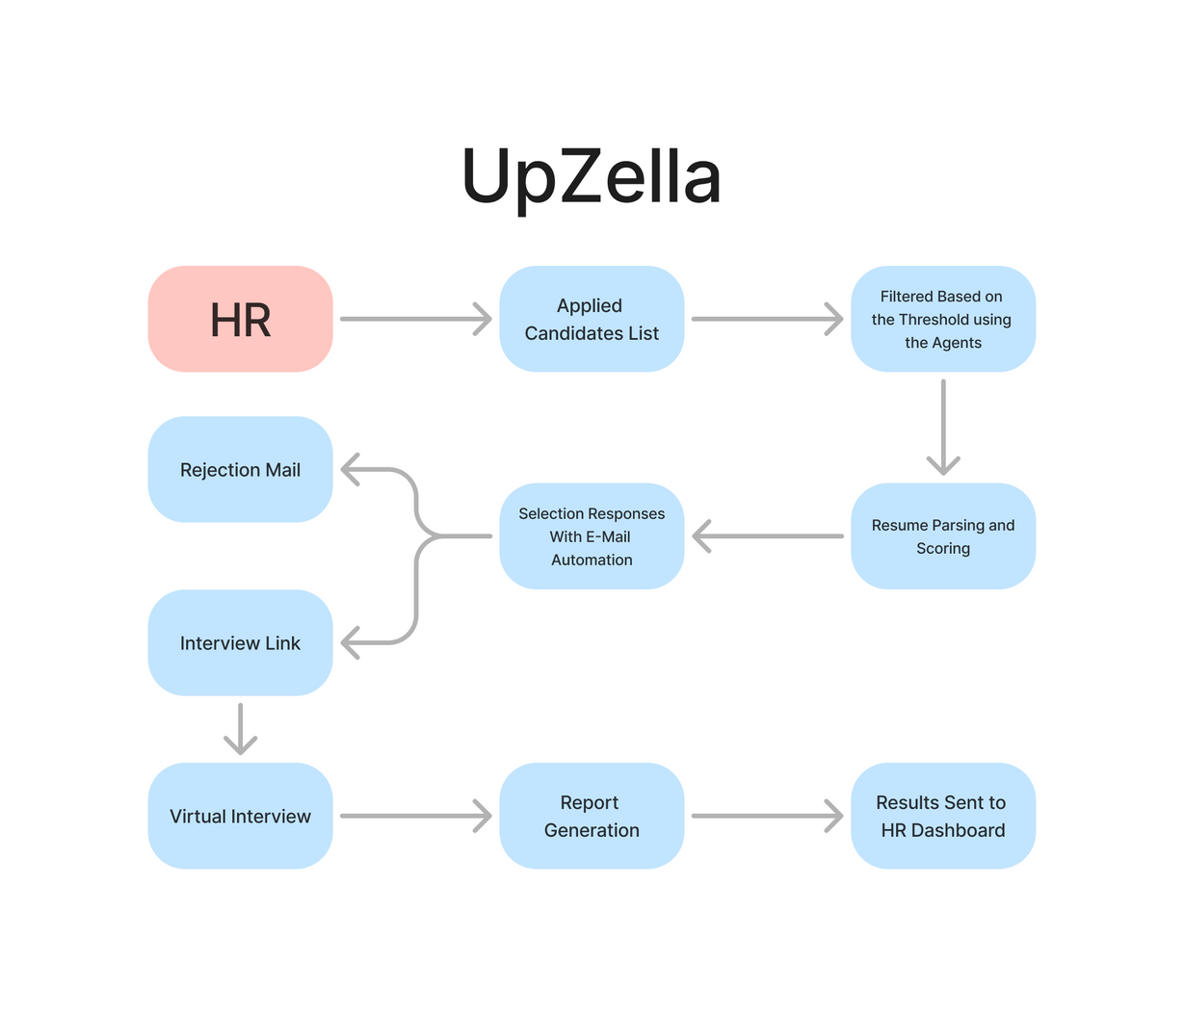
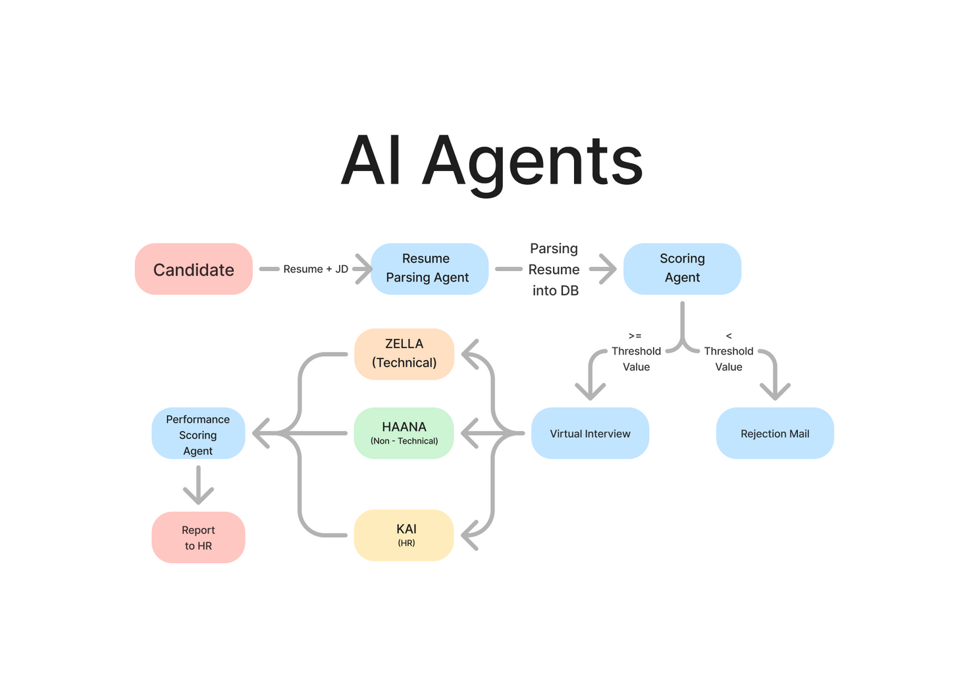
System Architecture

Slide 4
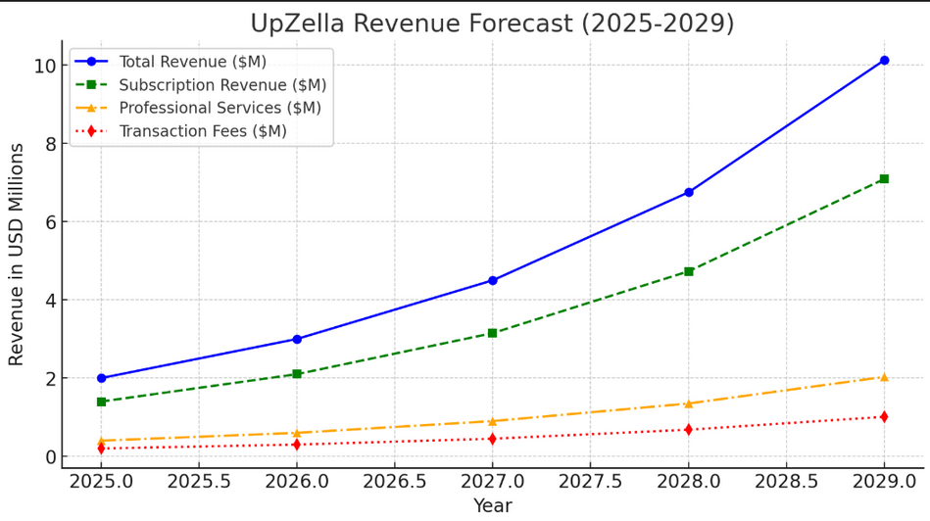
Relevancy & Business Opportunity
Revenue Stream
Efficiency Gains: Reduces hiring time by 50%, lowering costs.
Quality Hiring: AI improves accuracy by 30%, reducing bad hires.
Enhanced Productivity: Automates 70% of repetitive HR tasks.
Subscription Model (60%)
Basic ($99/user/month) – Resume screening, AI analysis
Pro ($299/user/month) – AI-powered interviews, coding tests
Enterprise ($50K+/year) – API access, white-label solutions
Pay-Per-Use (20%)
$10 – AI Resume Screening
$50 – AI Technical Interview
$100 – AI Video Interview (Facial Recognition)
500K+ assessments/year projected
Enterprise Licensing & API (15%)
$100K+/year – ATS integration & AI solutions
Marketplace & Commission (5%)
5% commission per hire (e.g., $500 on $10K placement)
Business Impact: Multiple revenue streams ensure scalability, profitability, and strong ROI.

Slide 5


Features & Customizations
Features
Customization
Future Scope
AI-Powered Screening
Customizable Hiring Process
Train Custom SLM
AI agents analyse resumes, assess skills, and assign scores.
HR can tailor job descriptions, application forms, and threshold scores.
User Responsive Interview (Synchronization)
Automated Shortlisting
Seamless CRM Integration
Candidates are shortlisted based on HR-defined thresholds.
Easily connect with Zoho CRM, HubSpot, HRMNest, and other HR systems.
Interactive Coding Environment
HR Dashboard & Workflow
Flexible Assessment Criteria
Manage job postings, track applicants, and streamline hiring.
Modify interview structures and evaluation parameters as needed.
Use Reflex Based Agents
Intelligent Interviews
AI conducts dynamic Q&A, live coding, and facial monitoring.

Slide 6




